Slide 1
BLOCKBANK GUARDIAN BANKING APP USING BLOCKCHAIN Technology
GUIDED BY ASST PROF. VIKAS K SOMAN DEPT OF CSE MUSALIAR COLLEGE OF ENGINEERING, CHIRAYINKEEZHU | PRESENTED BY FARZANA M R(MCC20CS022) MALAVIKA M S(MCC20CS029) NIKHILKUMAR R(MCC20CS037) PRANAV P S(MCC20CS038)

Slide 2
CONTENTS
INTRODUCTION
AREA OF PROJECT
OBJECTIVE OF PROJECT
LITERATURE SURVEY
EXISTING SYSTEM
DISADVANTAGES OF EXISTING SYSTEM
PROPOSED SYSTEM
ADVANTAGES OF PROPOSED SYSTEM
APPLICATION OF PROJECT
MODULES
SYSTEM DESIGN
REQUIREMENTS
OUTPUT
CONCLUSION
FUTURE ENHANCEMENT
ACHIEVEMENTS
REFERENCES

Slide 3
INTRODUCTION
Blockchain is a decentralized ledger with interconnected blocks.
Once a block is added, it cannot be altered & ensuring tamper-proof data.
Advanced encryption secures digital currency transactions on the platform.
Only authorized parties can access and perform transactions on the blockchain.
Banks using blockchain can enhance efficiency and reduce operational costs.
Blockchain enables banks to offer improved services to customers securely.

Slide 4
AREA OF PROJECT
In the era of digital economy, people switches their payments into digital transaction mode.
Blockchain technology is boon for the banking sector that enables transactions between people most secure and efficient way.
Blockchain transactions involve exchanging digital assets through a decentralized database.
Once the data gets recorded by the blockchain, can never be rewritten or changed. Thus the blockchain can be termed as a record book of all the transactions held.

Slide 5
OBJECTIVE OF PROJECT
Blockchain implementation aims to bolster security in bank transactions.
Introduces transparency through a decentralized, tamper-resistant ledger.
Aims to streamline processes, reduce fraud, and provide real-time transaction updates.
Utilizes a decentralized ledger to minimize the need for intermediaries.
Intends to reduce fraud by creating a tamper-resistant transaction history.
Ensures real-time updates on transactions for more timely and accurate information.

Slide 6
LITERATURE SURVEY
PAPER NAME | AUTHOR | ADVANTAGES | DISADVANTAGES
Decentralized Smart Contract Certificate System Using Ethereum blockchain Technology. | Dr Raghavender K V | Transparancy Immutability Decentralization | Scalabilty Complexity Cost
Exploring applications of blockchain in healthcare: road map and future directions. | Shishir Kumar | Interoperability Patient Empowerment | Regular compliance Complexity

Slide 7
LITERATURE SURVEY CONTD
PAPER NAME | AUTHOR | ADVANTAGES | DISADVANTAGES
Detecting Covid-19 chaos-driven phishing/malicious URL attacks by a fuzzy logic and data mining-based intelligence system. | Syed Rameem Zahra. | Fuzzy Logic Adaptability Advance Datamining technique Real-time Detection | High complexities High operational cost Low privacy
A blockchain-based models for student information systems | Sura I. | Immutable student data High data Security High student access | High Complexity High cost Need More database

Slide 8
LITERATURE SURVEY CONTD
PAPER NAME | AUTHOR | ADVANTAGES | DISADVANTAGES
The Use of Blockchain in Taxing Digital Products and Services: A Conceptual Model Proposal. | Sabri Erdem | Transparency Tracability Reduced fraud | Technical complexity Privacy concerns Scalability
Crystal: Enhancing Blockchain Mining Transparency With Quorum Certificate | Victor Leung | Enhanced transparency Improved trust | Complexity Cost Privacy concerns

Slide 9
LITERATURE SURVEY CONTD
PAPER NAME | AUTHOR | ADVANTAGES | DISADVANTAGES
Voting using Blockchain Technology | Mohammad Hajian. | Transparency High Security Tamper proof | Legal challenges High cyber attack High Complexity
Housing rental system based on blockchain Technology | Qingshui Xue | Transparent Efficient access Low cost | Complexity High network needed Less user privacy

Slide 10
LITERATURE SURVEY CONTD
PAPER NAME | AUTHOR | ADVANTAGES | DISADVANTAGES
Blockchain in Healthcare | Arjun Singh | Data integrity High Security Interoperability | Integration challenges Less scalability Large database needed
Real Estate Management System based on Blockchain | Ankit Mittal | High efficiency High Security | High risk between users in real estate

Slide 11
EXISTING SYSTEM
Use a centralized database for recording and tracking transactions.
Centralized systems have a single point of failure, risking entire transaction failure.
The central authority verifies transaction details and ensures fund transfer from sender to recipient.
Centralized transactions are fast and efficient but lack transparency.
Can be expensive, prone to fraud, and there's uncertainty about transaction success.

Slide 12
DISADVANTAGES OF EXISTING SYSTEM
Centralized database
Lack of transparency
Transaction delays
Slow transaction processing
High risk of Fraud
High security risks

Slide 13
PROPOSED SYSTEM
Proposed system is an application.
Developing for efficient local transaction storage.
Improving processes transparently for users.
Transactions, timestamp, and reference stored in blocks.
Forms chain of blocks.
Removes intermediaries in verification.

Slide 14
ADVANTAGES OF PROPOSED SYSTEM
Decentralization
Transparency
Immutability
Security and accuracy
Traceablity
Efficiency and speed
Consensus Mechanisms

Slide 15
APPLICATION OF TECHNOLOGY
Banking And Finance
Health Care
Real Estate
Voting System
Identity Management

Slide 16
MODULES
ADMIN MODULE
Admin module manages user verification requests within the blockchain-based application.
Acts as a vital communication channel between administrators, users, and customer support representatives.
Ensures prompt resolution of user verification requests and efficient handling of customer inquiries and issues.
Provides essential functionalities for facilitating customer support interactions.
Aims to streamline the process of user verification and customer support interactions for enhanced efficiency.

Slide 17
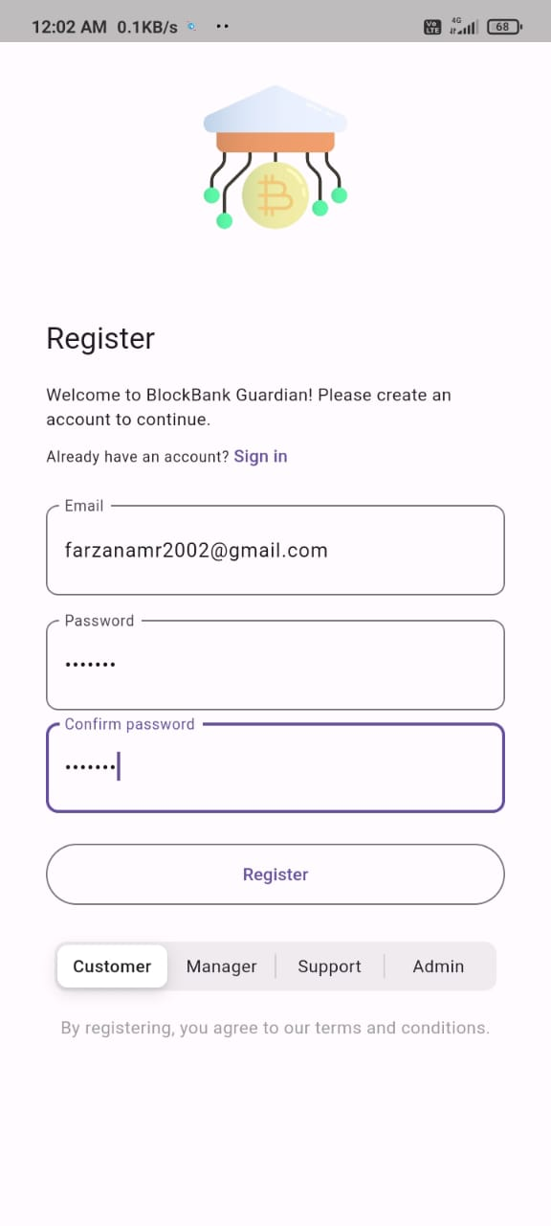
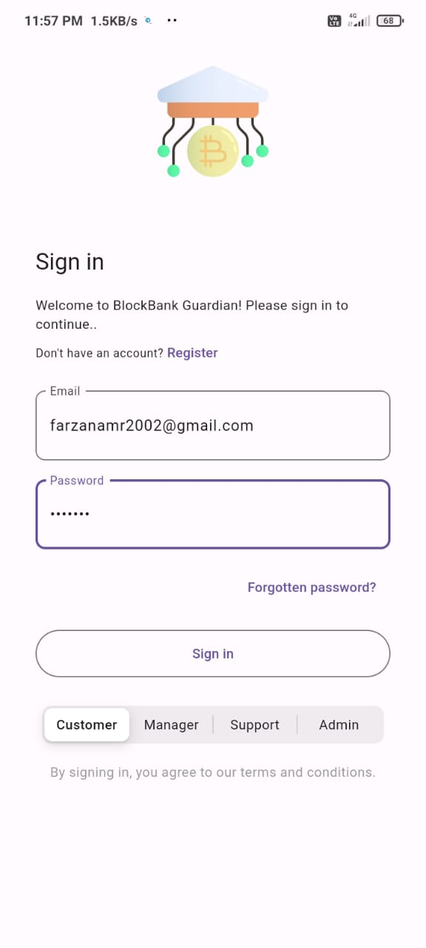
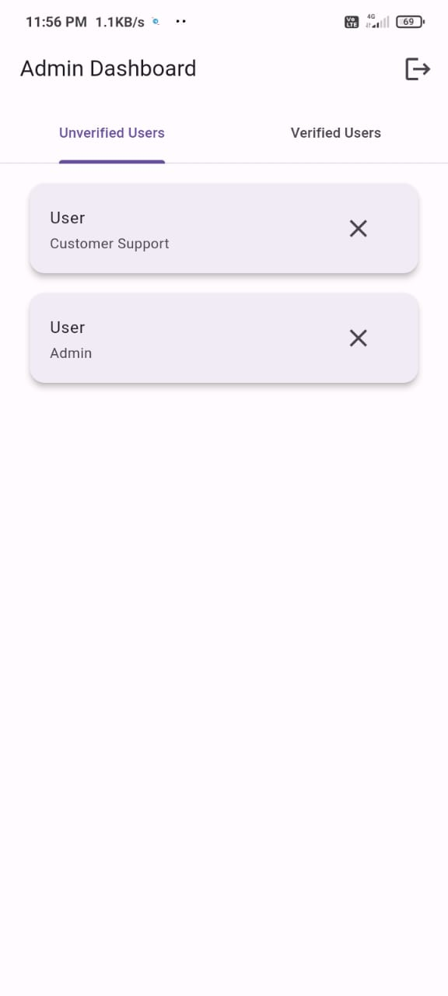
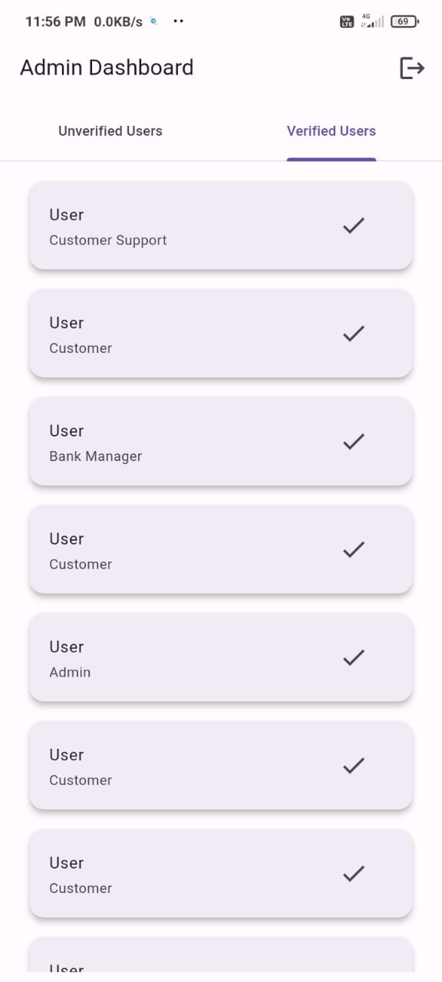
ADMIN MODULE

Slide 18
MODULES CONTD
BANK MANAGER MODULE
Bank Manager Dashboard is the hub for overseeing and administering customer accounts and transactions.
Provides tools and functionalities for efficient management and monitoring of customer accounts and transactions.
Generates reports to ensure compliance with regulations and aids in strategic decision-making.
Empowers bank managers with the necessary tools to manage accounts and monitor transaction activities efficiently.
Facilitates strategic decision-making by offering comprehensive control and oversight functionalities.

Slide 19
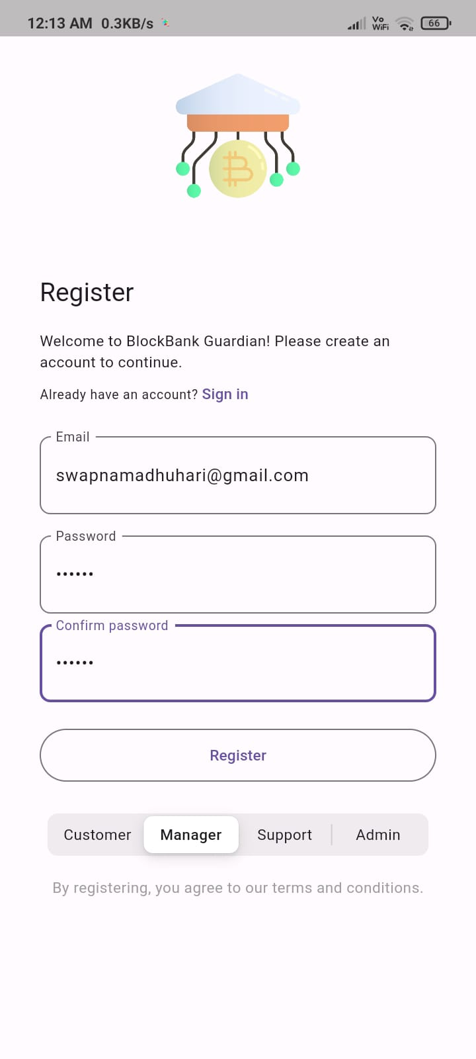
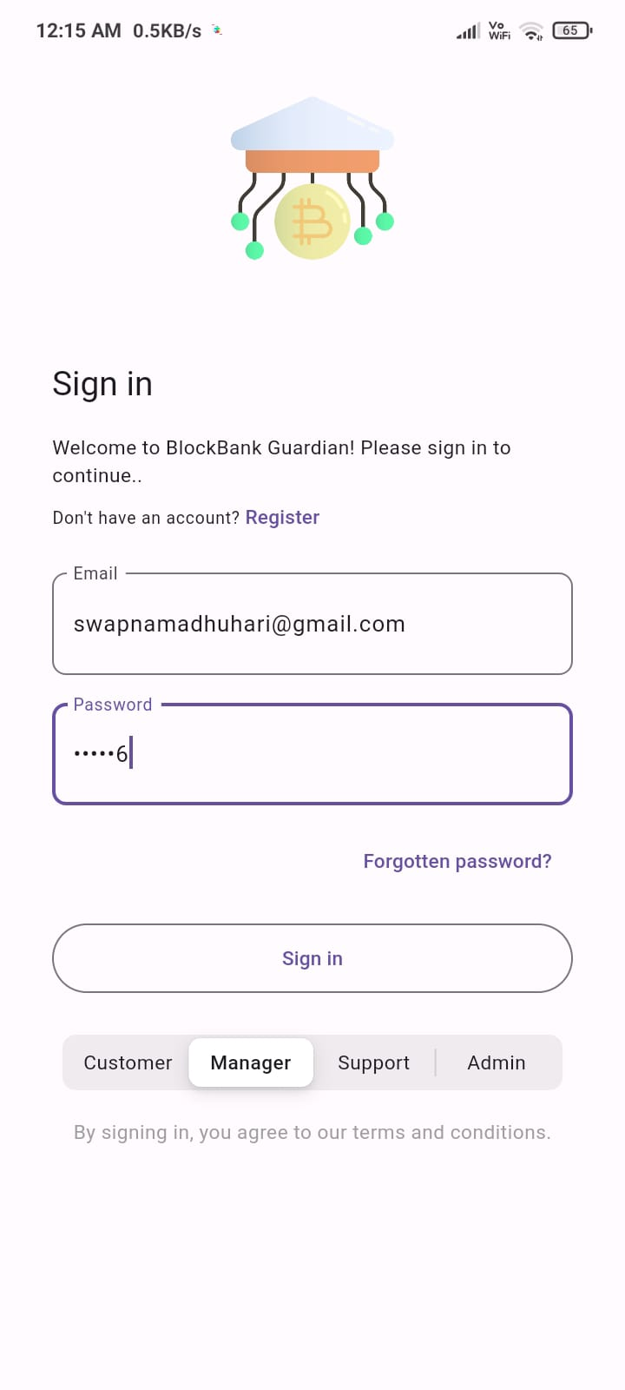
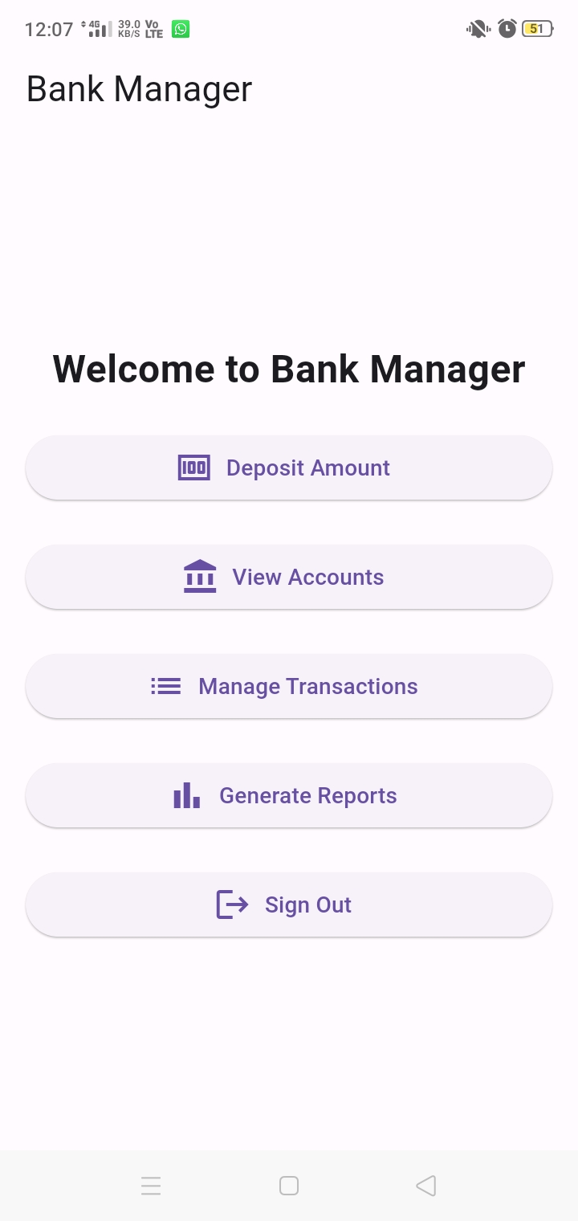
BANK MANAGER MODULE

Slide 20
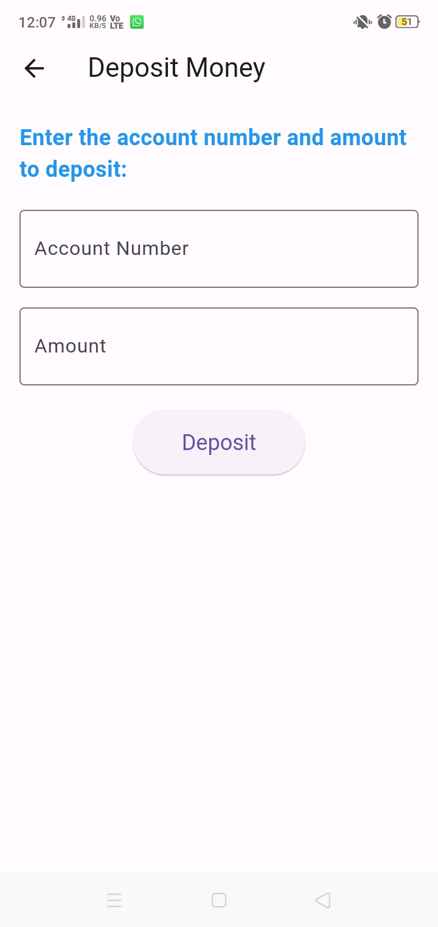
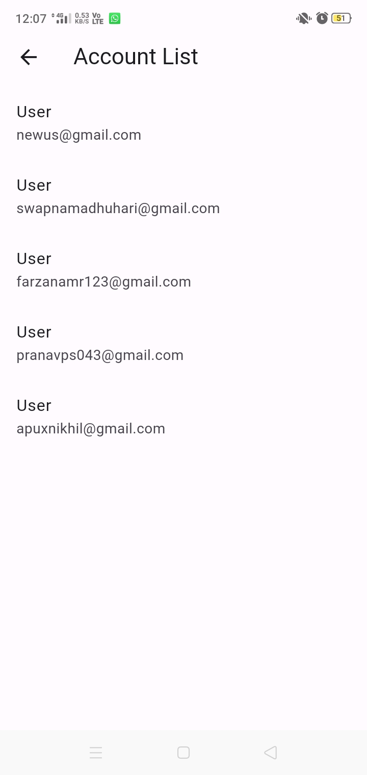
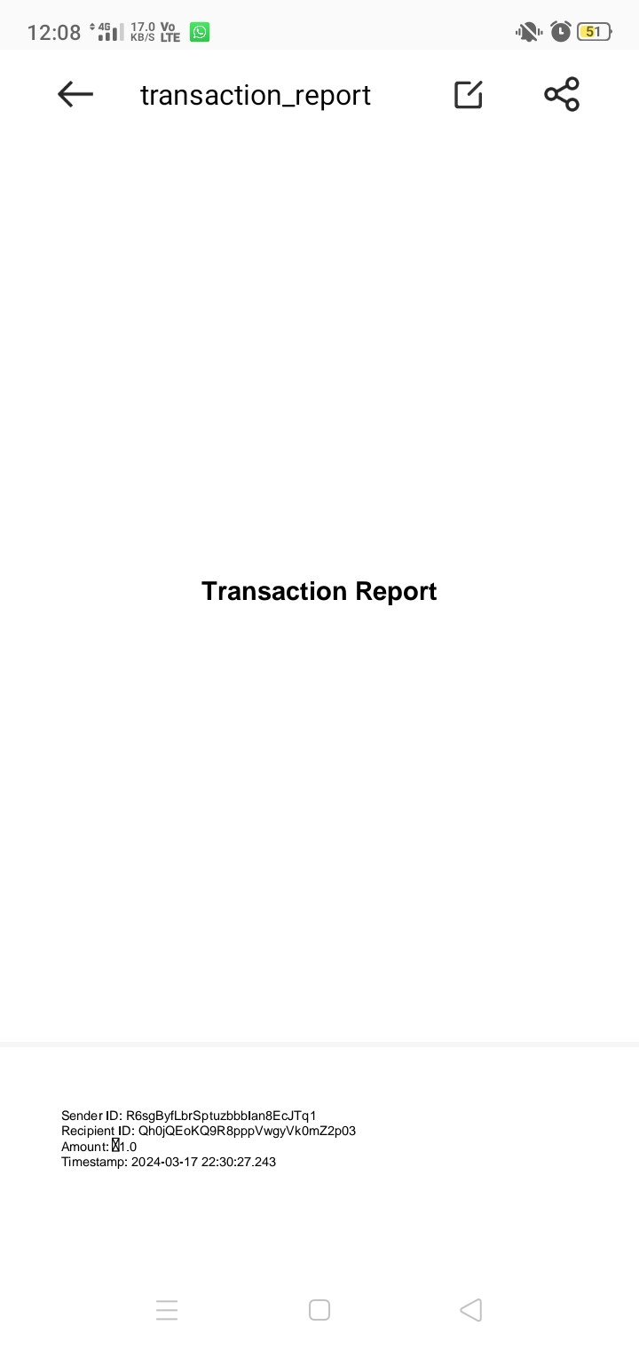
BANK MANAGER MODULE

Slide 21
MODULES CONTD
USER MODULE
The User module is where users engage with the blockchain-based application.
Users can access and manage their accounts and transactions within the interface. Designed for a smooth and hassle-free user experience.
Prioritizes security to ensure user data and transactions are protected.
Empowers users to perform various actions related to their virtual money holdings with ease.

Slide 22
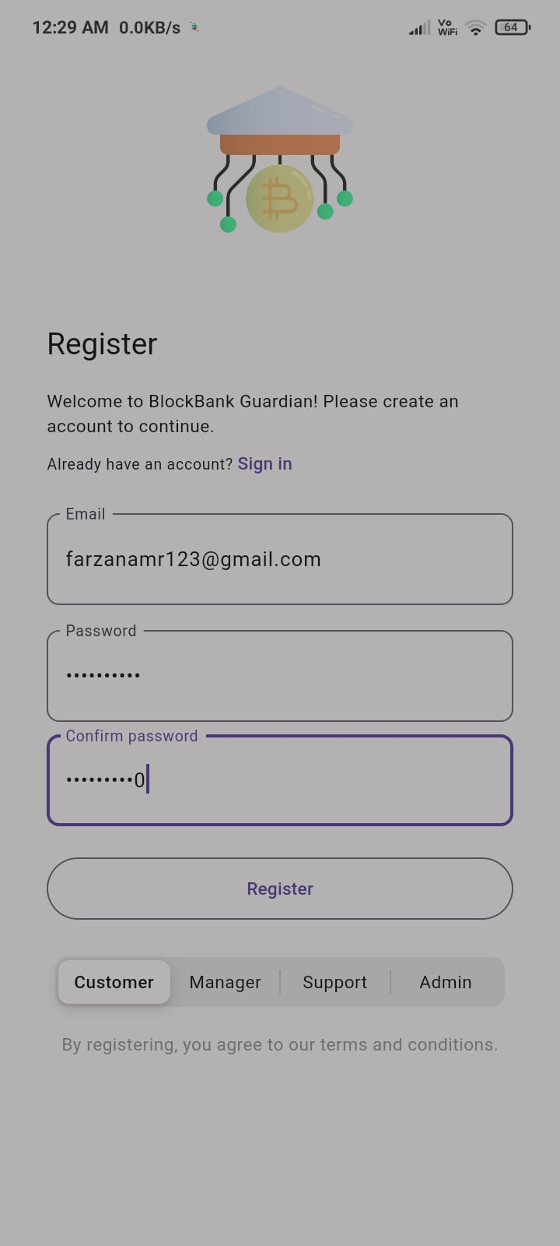
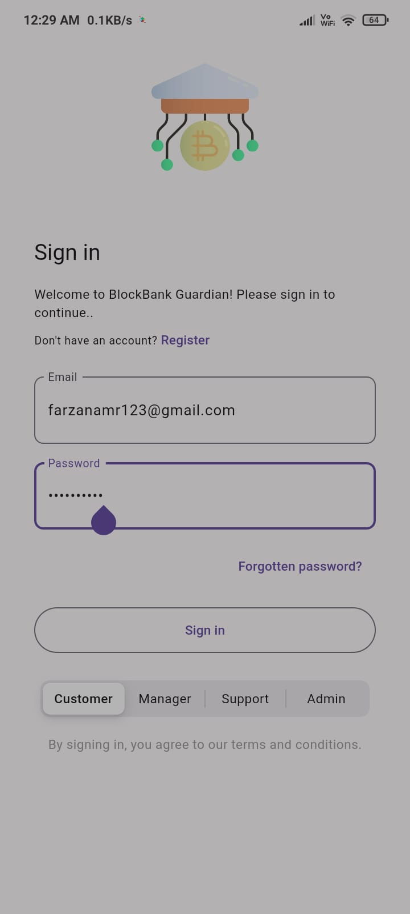
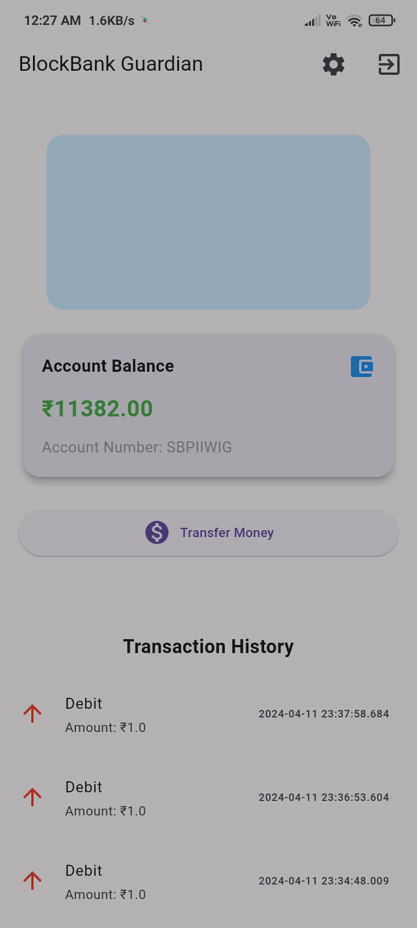
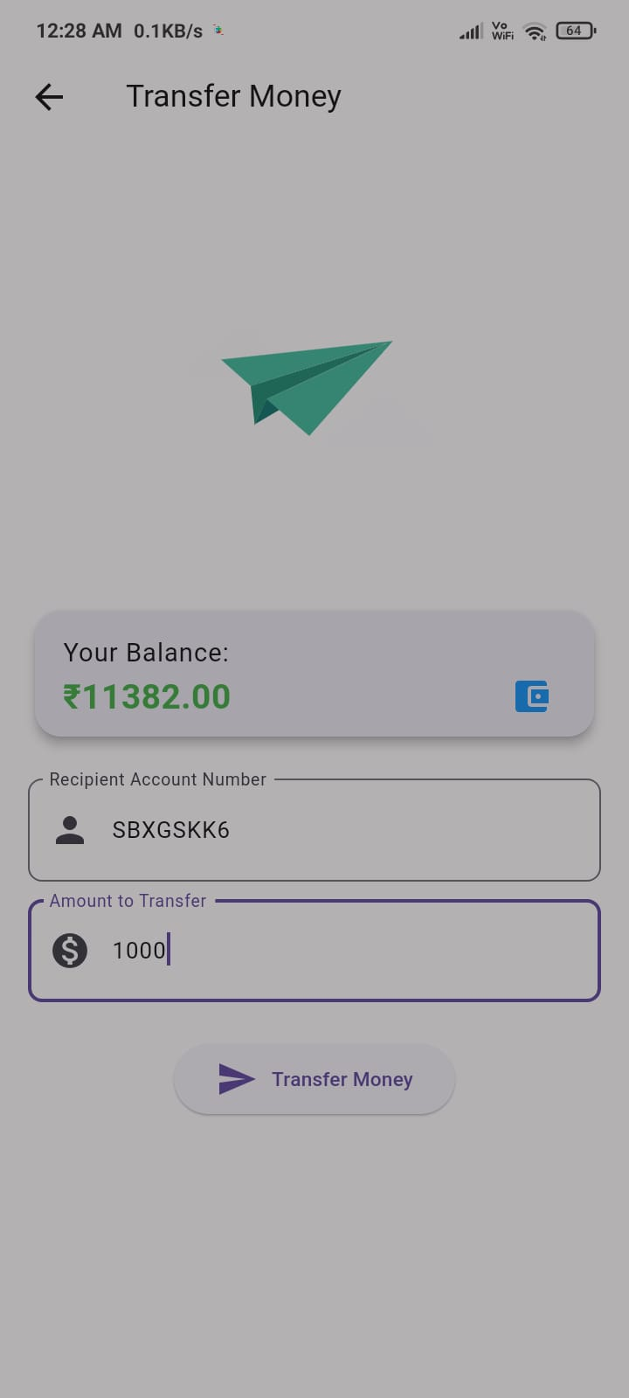
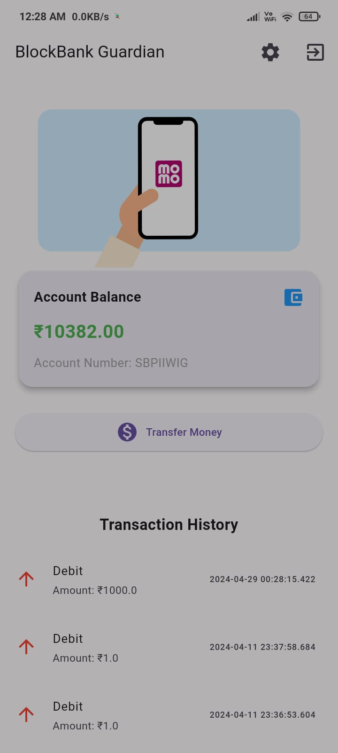
USER MANAGEMENT MODULE

Slide 23
MODULES CONTD
CUSTOMER SUPPORT MODULE
Customer Support module is a dedicated platform within the blockchain-based application.
Users can seek assistance and resolve inquiries effectively through this module.
Facilitates effective communication between users and support representatives.
Prioritizes responsive and personalized customer service to enhance user satisfaction.
Aims to resolve issues promptly to ensure a positive user experience.

Slide 24
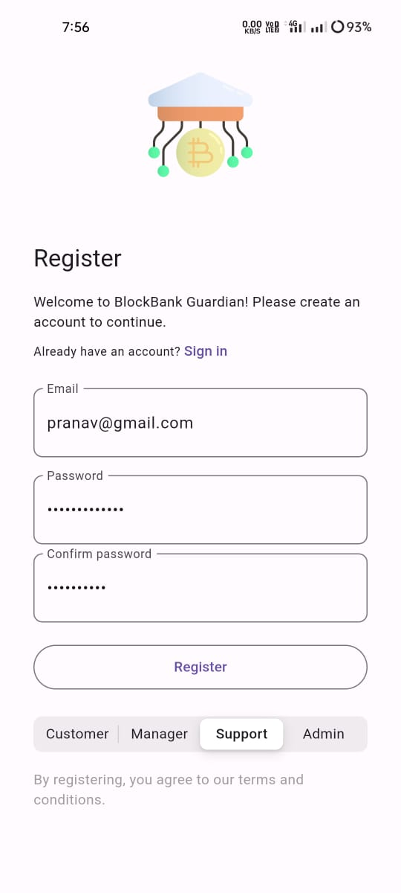
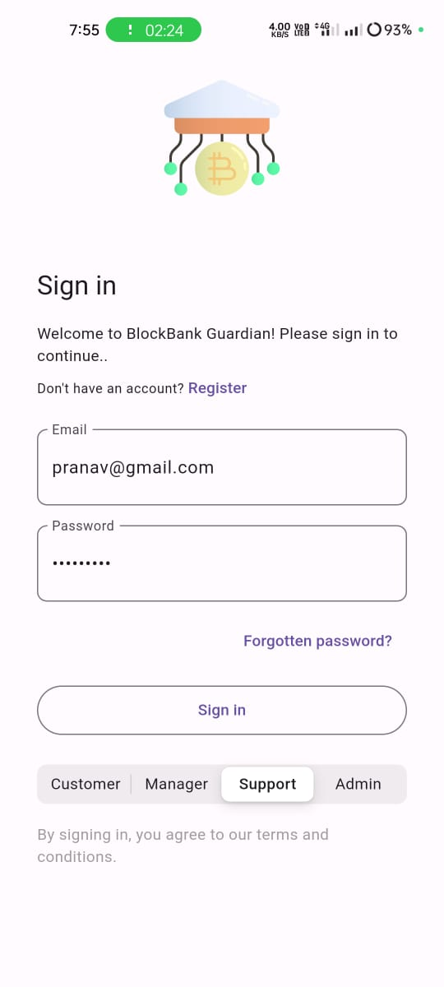
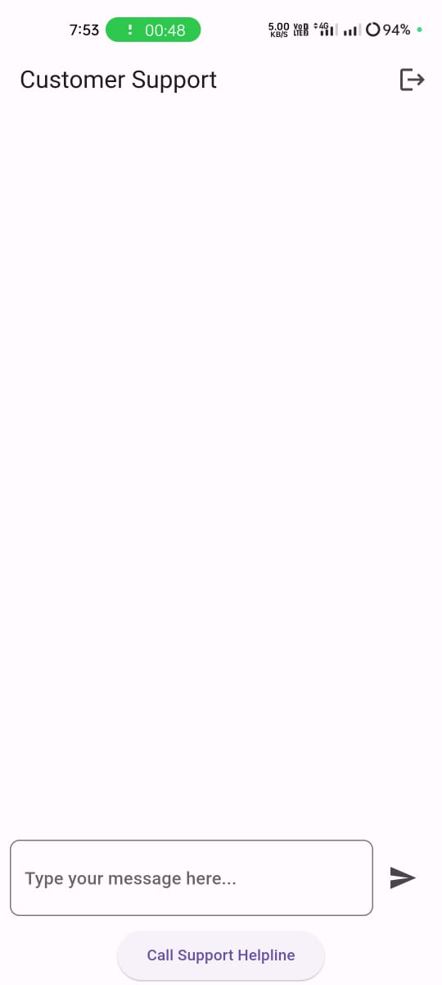
CUSTOMER SUPPORT MODULE

Slide 25
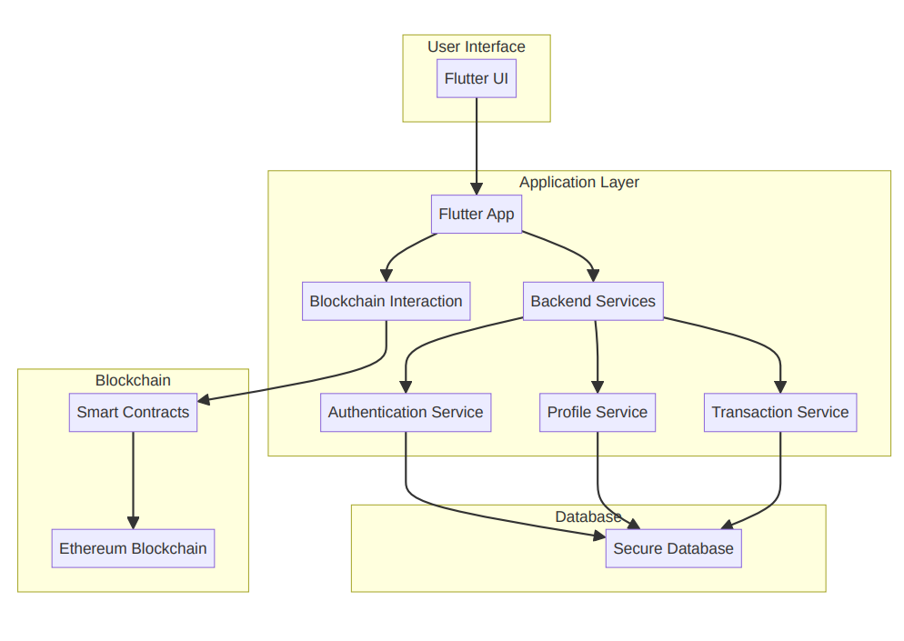
SYSTEM DESIGN

Slide 26
REQUIREMENTS
Development Environment: Set up development environments for Flutter, Ethereum, and Firebase
Programming Languages: Dart (for Flutter), Solidity (For Ethereum), and JavaScript (for Firebase).
IDE: IAndroid Studio for Flutter and Visual Studio Code for Ethereum
Database Design: Firebase Realtime Database is to store user data, transactions, and other relevant information.
Blockchain Smart Contracts: Develop and test smart contracts (Solidity) for Ethereum to manage banking operations securely.
API Development: Create restful or APIs for communication between the Flutter app and the Ganache Ethereum blockchain app.

Slide 27

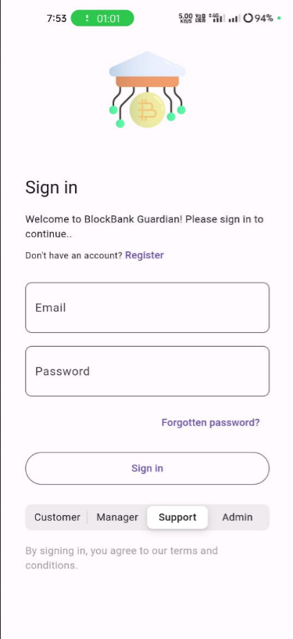
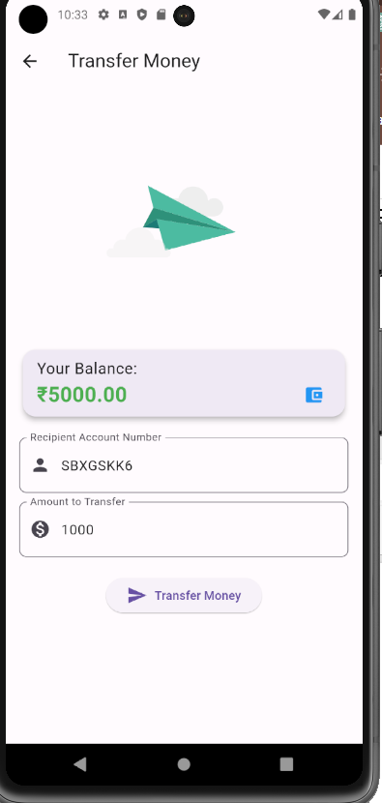
OUTPUT

Slide 28
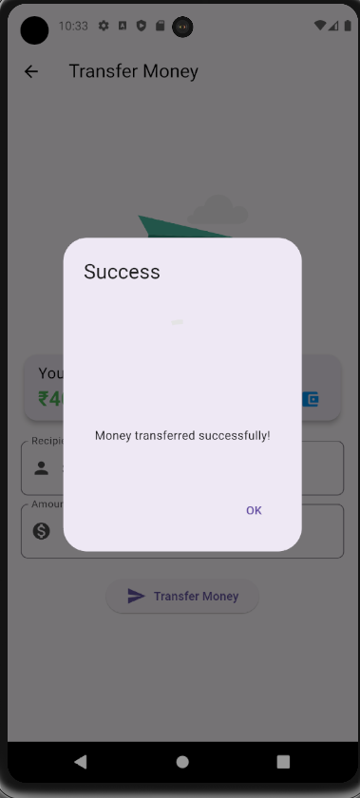
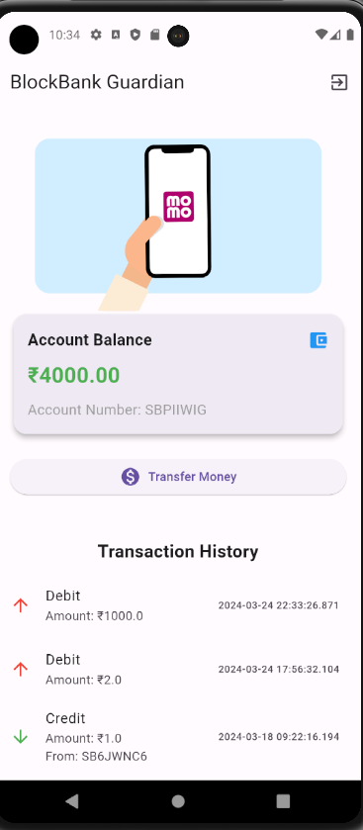
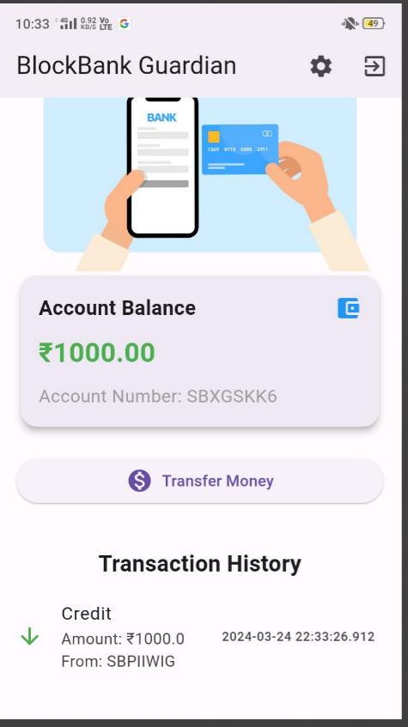
OUTPUT

Slide 29
CONCLUSION
Leveraged Ethereum blockchain for secure banking applications.
Integrated Flutter and Ganache for user-friendly interface and local blockchain testing.
Enabled account creation, fund transfers, and profile management through Solidity smart contracts.
Provided secure financial services worldwide, promoting transparency and accessibility.
Demonstrated blockchain's role in enhancing security and transparency, aiming for seamless integration into daily banking operations.

Slide 30
FUTURE ENHANCEMENT
Expand into DeFi for advanced financial services.
Offer lending and borrowing.

Slide 31
ACHIEVEMENTS
Our paper on the project has been accepted to the national conference on Interdisciplinary perspectives of emerging trends in computing-24 conducted on 12 April 2024 at Carmel College of Engineering and Technology, Punnapra, Alappuzha.

Slide 32
REFERENCES
S.Nakomoto, “Bitcoin: A Peer-to-Peer Electronic Cash System”. Cryptography Mailing list at https://metzdowd.com. Oct 2008.
Androulaki, Elli, Artem Barger, Vita Bortnikov, Christian Cachin, Konstantinos Christidis, Angelo De Caro, David Enyeart et al. "Hyperledger fabric: a distributed operating system for permissioned blockchains." In Proceedings of the thirteenth EuroSys conference, pp. 1-15. 2018.
P. Hooda, "Proof of Work (PoW) Consensus - GeeksforGeeks", GeeksforGeeks, 2019. [Online]. Available: https:// www.geeksforgeeks.org/proof-of-work-pow-consensus/.
P. Hooda, "practical Byzantine Fault Tolerance,", GeeksforGeeks, 2019. [Online]. Available: https://www.geeksforgeeks. org/practical-byzantine-fault-tolerancepbft/.

Slide 33
REFERENCES CONTD
P. Javeri, "Smart Contracts and Blockchains", Medium, 2019. [Online]. Available:https://medium.com/@prashunjaveri/smart-contracts-and-blockchains-c24538418bf6.
W. Kenton, "Proof of Burn (Cryptocurrency) Definition", Investopedia, 2019. [Online]. Available: https://www.investopedia.com/ terms/p/proof-burn-cryptocurrency.asp.
P. Hooda, "Proof of Stake (PoS) in Blockchain,", GeeksforGeeks, 2019. [Online]. Available: https://www.geeksforgeeks. org/proof-of-stake-pos-in-blockchain/.
T. Marler, "Hyperledger Fabric: Transaction," Medium, 2018. [Online]. Available: Hyperledger Fabric Medium
P. B, "Architecting a Hyperledger Solution - Things to keep in mind," Hackernoon, 2018. [Online]. Available: Hyperledger Fabric Hackernoon

Slide 34
THANK YOU

